Slide 1
Team 201
Sprint 1

Slide 2
Burndown Chart
1
Let’s start with a graphical representation of our progress

Slide 3
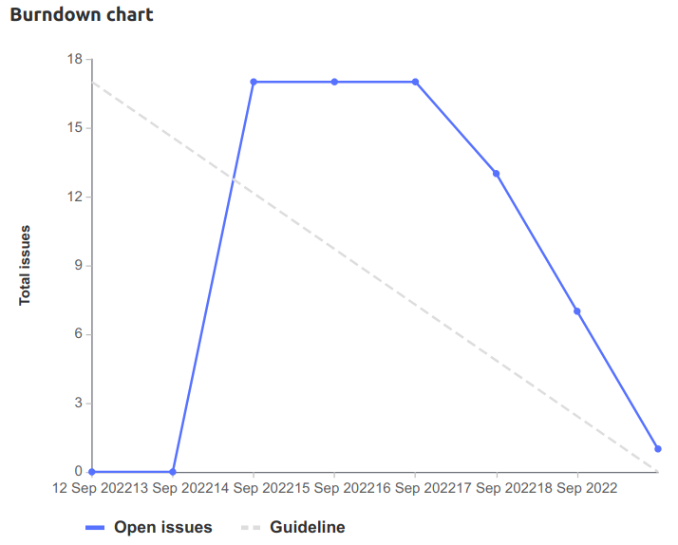
BURNDOWN CHART

Slide 4
Retrospective
2
Let’s review what went well and how we can improve

Slide 5
WHAT WENT WELL AND NOT WELL
Well
Sprint planning meeting
Large amount of code written quickly
Completed nearly all of our planned tasks
Not Well
Planning happened too late
Difficult to reach people
Overlapping tasks caused our estimates to often be incorrect
Waiting for people to start working on tasks

Slide 6
HOW WE CAN IMPROVE
Problems
Planning happened too late
Difficult to reach people
Overlapping tasks caused our estimates to often be incorrect
Waiting for people to start working on tasks
Solutions
Start planning earlier
Turn on notifications and be try to be reachable more often
Spend more time planning
Don’t assign people to tasks during planning

Slide 7
Team Member Contributions
3
Let’s see what we worked on this sprint

Slide 8
CONTRIBUTIONS - ETHAN
Sprint 1 planning meeting (GL#19) [2h]
Set up kanban board and created issues in GitLab (GL#8) [2h]
Improved the project structure (GL#17) [1.5h]
Pair programming with Sahil and Nash (GL#1, GL#2, GL#5) [4.5h]
Added extra parsing code for our complex data structures (GL#23) [2h]
Set up unit testing (GL#24) [1.5h]
Add functions for displaying courses in searching program [3h]

Slide 9
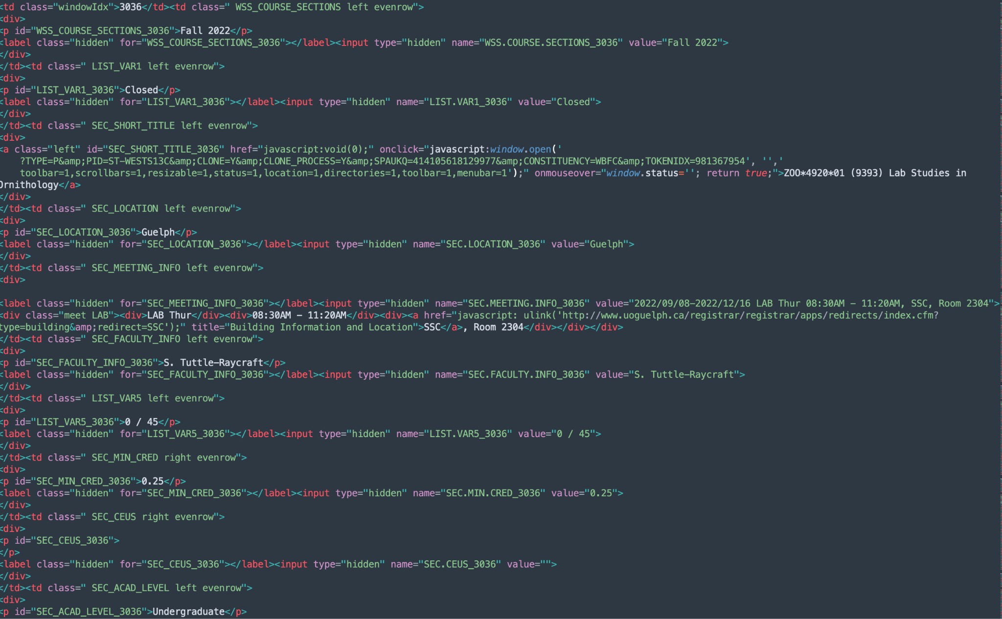
INITIAL PARSING - NASH
Need to translate into something we can use
To do this we need to read each tag and content, determine it is useful, and turn it into a string which we can convert into a JSON object
Once read it should be easy to store

Slide 10
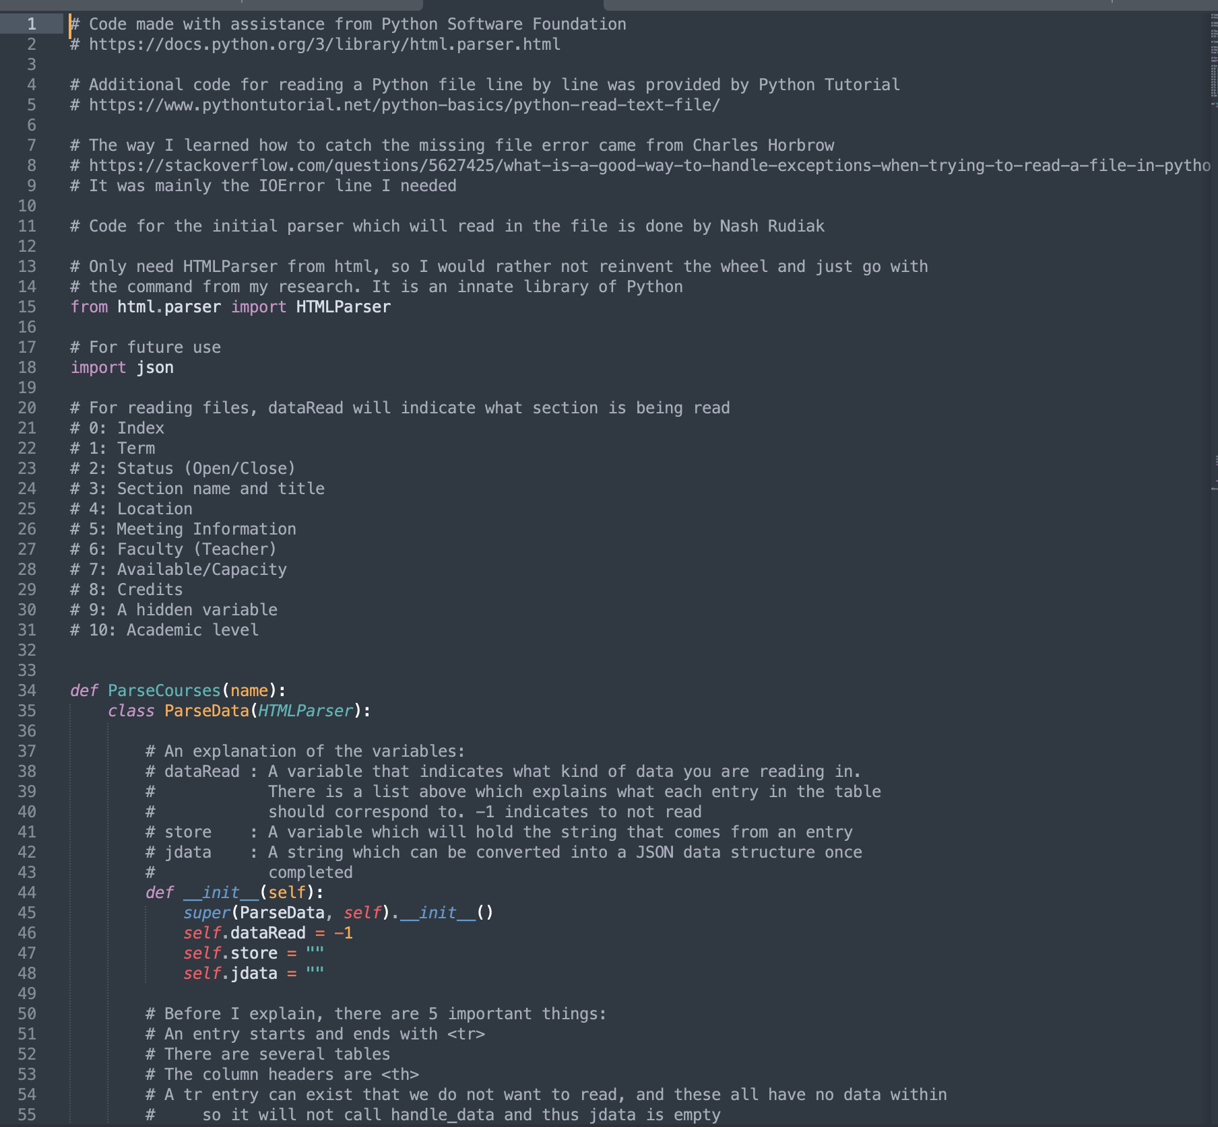
INITIAL PARSING - NASH
Did research for understanding the HTML document
Created code to grab content, ignoring HTML elements that are irrelevant for the data set
Created code to turn content into a JSON string
Documentation for courseparser.py
Additional help for improving code was done by Ethan and Sahil

Slide 11
CONTRIBUTIONS - AMEER
Developed initial searching, and worked with Kal to complete
Developed unit tests for CourseParser with Sahil
Wrote documentation on our JSON format
Researched docker implementation with Python

Slide 12
CONTRIBUTIONS - SAHIL
Sprint 1 planning meeting (GL#19) [2h]
Improved the project structure with Ethan (GL#8) [1h]
General programming with Ethan [2h]
Designed course data structures(GL#2) [1h]
Researched and documented the format of the exported data (GL#3) [1h]
Exported parsed data into a file (GL#5) [2h]
Wrote Unit tests for untested code (GL#10) [2h]

Slide 13
CONTRIBUTIONS - DOGU
Tested the code on different platforms Windows, Linux, Mac.
Sprint1 planning meeting and code review session.
Researched VBA.

Slide 14
CONTRIBUTIONS - KALINDU
Developed initial searching by course code with Ameer
Developed advanced course searching:
Searching by course name
Searching by professor name

Slide 15
Demo
4
A live demonstration of our work so far

Slide 16
CREDITS
Special thanks to all the people who made and released these awesome resources for free:
Presentation template by SlidesCarnival
Photographs by Unsplash

